Slide 1

OpenDaylight project introduction
An open source project under the Linux Foundation with the goal of furthering the adoption and innovation of Software Defined Networking (SDN).

Slide 2

















Networks are Evolving
Software Defined Networking (SDN) reset business opportunities
Applications and services that ride on, optimize, exploit, and manage the network
Security, load
balancing, etc. services
Focus Area
for OpenDaylight
Enterprise apps
A Software Defined Network platform that makes the network more programmable, agile, and efficient
API’s
Software Defined Network (SDN)
Platform
Open protocols with enablement for proprietary extensions
A network that provides the physical connectivity
Physical Network
Physical Network

Slide 3

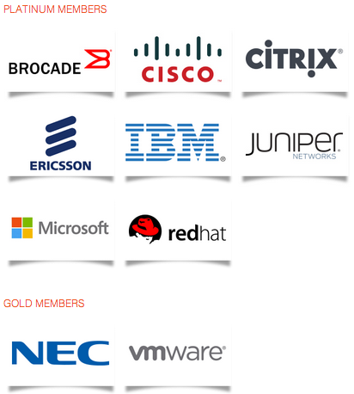
What is OpenDaylight Project?
OpenDaylight is an open source project under the Linux Foundation with the mutual goal of furthering the adoption and innovation of Software Defined Networking (SDN) through the creation of a common industry supported framework.

Slide 4

OpenDaylight Project Goals
Code: To create a robust, extensible, open source code base that covers the major common components required to build an SDN solution
Acceptance: To get broad industry acceptance amongst vendors and users
Community: To have a thriving and growing technical community contributing to the code base, using the code in commercial products, and adding value above, below and around.

Slide 5

Industry Value
A broad SDN code base that anyone can use, plug into or contribute new enhancements
A common environment for users and application developers
Accelerated innovation by avoiding duplication of basic infrastructure
Faster and higher quality development through sharing of resources

Slide 6
Open governance
Membership open to all
Business leadership: Board of Directors
  Governance, marketing, operations
Technical leadership: Technical Steering Committee (TSC)
  Technical direction, project selection, technical decisions
  Meritocracy and Transparency
  Project life-cycle management

Slide 7

The Code
A wide array of technologies contributed by leading companies and developers
  Pre-existing code, newly created code specifically for OpenDaylight
Roughly bi-annual coordinated release cycles
  First release planned for December 2013
Eclipse Public License (EPL)

Slide 8
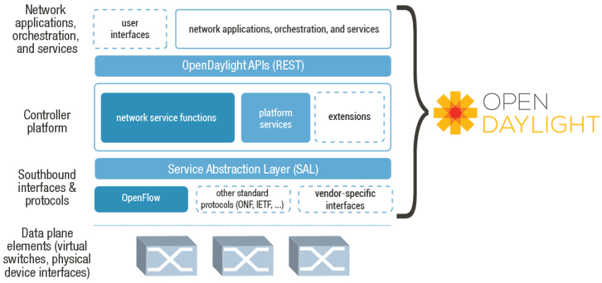
Project Framework

Slide 9
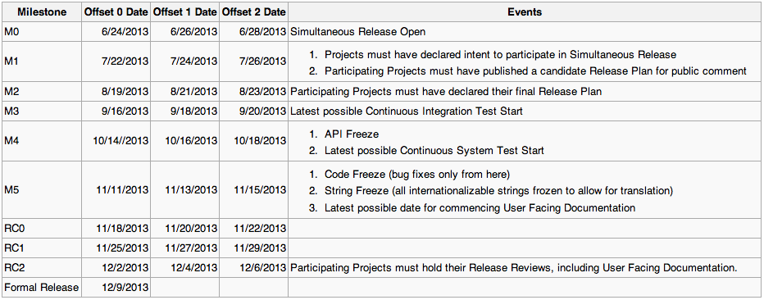
Simultaneous Release Plan

Slide 10
Projects in the “Hydrogen” OpenDaylight release
Project | Description | Originator (others)
controller | modular, extensible, scalable, and multi-protocol SDN controller based on OSGi | Cisco (minor: IBM, RedHat, NEC, etc.)
vtn | multi-tenant network virtualization application using OpenFlow | NEC
yangtools | Java-based NETCONF and YANG tooling for OpenDaylight projects | Cisco
openflowjava | OF 1.3 protocol library implementation | Pantheon (IBM, Cisco, Ericsson)
openflowplugin | Integration of OpenFlow protocol library in controller SAL | Ericsson, IBM, Cisco
affinity | APIs to express workload relationships and service levels | Plexxi
defense4all | DDoS detection and mitigation framework | Radware
bgpcep | support for traffic engr with BGP-LS (BGP protocol library and topology model) and PCEP (path programming model) | Cisco
ovsdb | OVSDB configuration and management protocol support (e.g., for Open vSwitch and other OVSDB servers) | Univ. of Kentucky (Cisco)
lispflowmapping | LISP (locator/identifier separation protocol) plugin, LISP mapping service (can be used to implement virtual networks) | ConteXtream (Cisco)
snmp4sdn | SNMP protocol support; APIs to manage commodity Ethernet switches | Industrial Technology Research Inst. (Taiwan)
opendove | multi-tenant network virtualization based on overlays, including ctrl plane and OVS-based data plane | IBM

Slide 11


Resources
More information and to join:
  www.opendaylight.org
    info@opendaylight.org
Keep informed
  @openDaylightSDN

